Slide 1
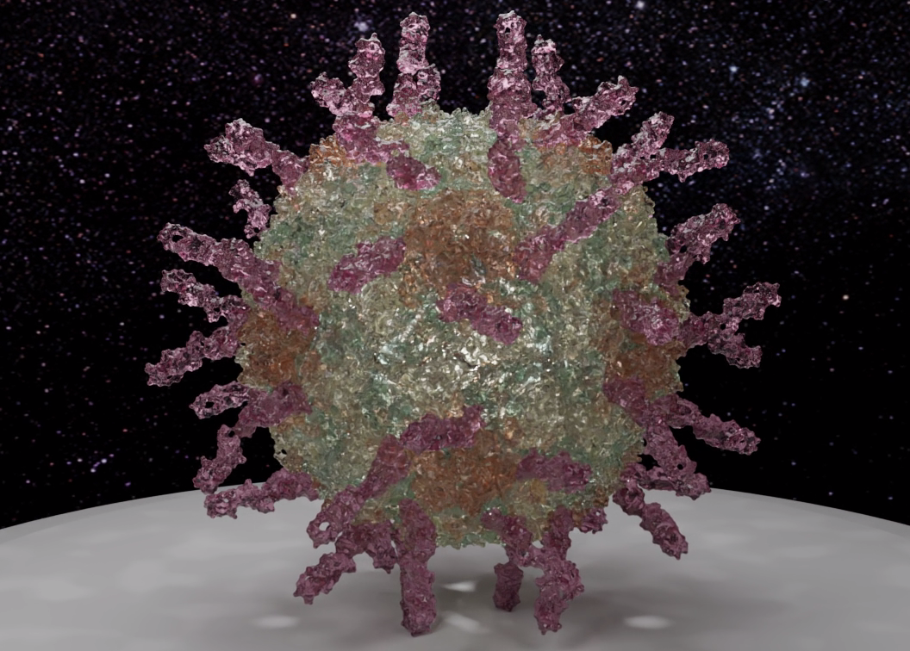
Visualizing with Video
Visualizing Science: Back To Basics
Gary Oberbrunner
Dark Star Systems, Inc.
garyo@darkstarsystems.com
Notes:
Hi, I’m Gary Oberbrunner. Thanks so much for having me here; it’s an honor!
I spent the last 20 years doing visual effects for movies and TV. Before that I did visualization on supercomputers; with my new company, Dark Star Systems, I’m creating web-based tools to help scientists create beautiful videos of their data. And by the way I grew up in upstate NY; wish we could be there in person today!
Today I’ll tell you about visualizing scientific data with video.

Slide 2
Outline
Overview of Scientific Visualization
Video and the Language of Film
Scientific Visualization and Video
Notes:
My talk will be in three parts: overview of what scientific visualization is all about, video and the language of film, and how to put those parts together so you can create your own sci viz videos.

Slide 3
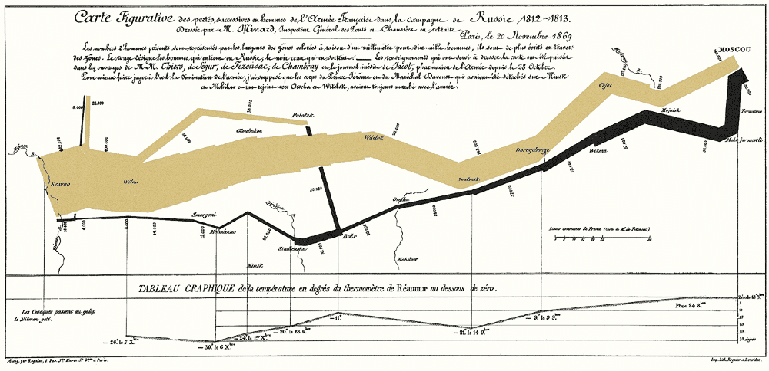
Visualization: Effective Communication
Visualization is just a part of scientific communication
The goal is to communicate insight, not just data
Key principles:
  Know your audience: tell a story, don’t just state facts. Connect with them!
  Know your goals: what is the insight? What do you want to highlight?
  Know your data: deep understanding allows for effective visualization – and creates deeper understanding
Notes:
Visualization, which I define as the art of turning scientific data into imagery, is just a part of scientific communication. An important part, sure, but it all has to start with a story. Just like in movies, cool visuals don’t make up for a lame plot. We’ll focus on visuals today, but don’t neglect the storytelling aspects! I’ll put some links at the end of my slides if you’re interested.
The goal of visualization is to help the viewer see what’s important and interesting about the data, to communicate insight.
A secondary goal is to make your presentation more interesting: video draws people in and makes them pay more attention. We’ll talk more about video in a few minutes.
My key principles for effective visualization are to know your audience, know your goals, and to know your data.

Slide 4

Know Your Audience
What are they looking for? (Could be you!)
What’s their knowledge level?
How much detail are they ready for?
Do they want subjective/qualitative interpretation or objective/quantitative fact?
Are they receptive to casual, serious, funny?
What’s the one message you want them to remember?
Photo Credit: Marla Aufmuth/TED
Notes:
What kind of presentation are you giving? Is it to a group of scientists, an investor, a funder, a journalist, or school children?
I’ve found it incredibly helpful to answer these questions as I think about a scientific presentation.
They help jolt you out of thinking like a researcher, and into thinking like a storyteller and empathizing with your audience, which is important for any story.
The key question is the last one: what’s the one-sentence message you want them to remember?
And that brings us to your goals:

Slide 5
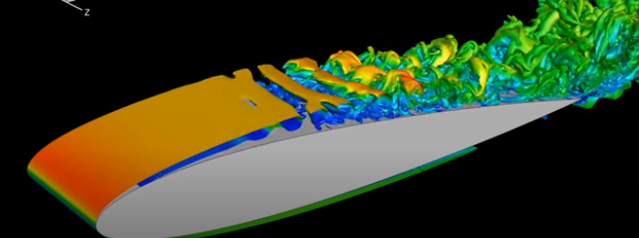
Understand Your Goals
Is your goal to inform, explain, entertain, explore, inspire, discuss …?
What do you want to show?
Form and Structure
  Identify, locate, categorize, explore
  Typically single data set
  Surface, volume, images, slices, models
Relationships: Compare and Contrast
  Compare, distinguish, reveal, relate
  Multivariate data, evolution, simulation vs. experiment,
Time: Process, Motion, Animation
  Change in shape, volume, value, location, composition
Photo Credit: Shock Wave Lab, RWTH Aachen
Notes:
Before you start in to visualizing data, you have to know why you’re doing it!
Often visualization is done early in the pipeline, to explore the data and discover insights as you go.
More commonly, it’s an afterthought, done as part of presenting your work.
Ideally, you’ll be thinking visually all throughout the discovery process, and beautiful visuals will be a natural result!
[Then talk about the three types]

Slide 6
Know Your Data
Types of Data: categorize by dimensionality
1 independent var (X, time, etc.): graphs, charts, sparklines, icons
2d/3d: “spatial” data
  2 spatial variables (X, Y): image (maybe pseudocolor), height field, contour maps, streamlines for vector fields, icons (arrows etc.)
  3 spatial variables (X, Y, Z volumetric): volume rendering, isosurfaces, streamlines
  add time: becomes video
  can have many dependent variables; OK to overlay different techniques
Specialized: atomic structures, irregularly sampled data, multigrids
Abstract/list data: more challenging, becomes “information visualization”
  examples: graph/network structures, lists, high-dimensional data sets
Notes:
Deep understanding of your data allows you to visualize it effectively, so it shows, rather than tells, the key ideas.
[Talk about each one]
I put “spatial” in quotes because nearly anything with 2 or 3 independent vars can be made spatial:
Abstract: List of movies with dates, stars, directors
Graph: degrees of connectivity between individuals/groups

Slide 7
Dimensionality and Viz Techniques
1 independent var (X, time, etc.): graphs, charts, sparklines, icons
2d/3d: “spatial” data
  2 spatial variables (X, Y): image (maybe pseudocolor), height field, contour maps, streamlines for vector fields, icons (arrows etc.)
  3 spatial variables (X, Y, Z volumetric): volume rendering, isosurfaces, streamlines
  add time: becomes video
  can have many dependent variables; OK to overlay different techniques
Specialized: atomic structures, irregularly sampled data, multigrids
Abstract/list data: more challenging, becomes “information visualization”
  examples: graph/network structures, lists, high-dimensional data sets
Notes:
[Talk about these]

Slide 8
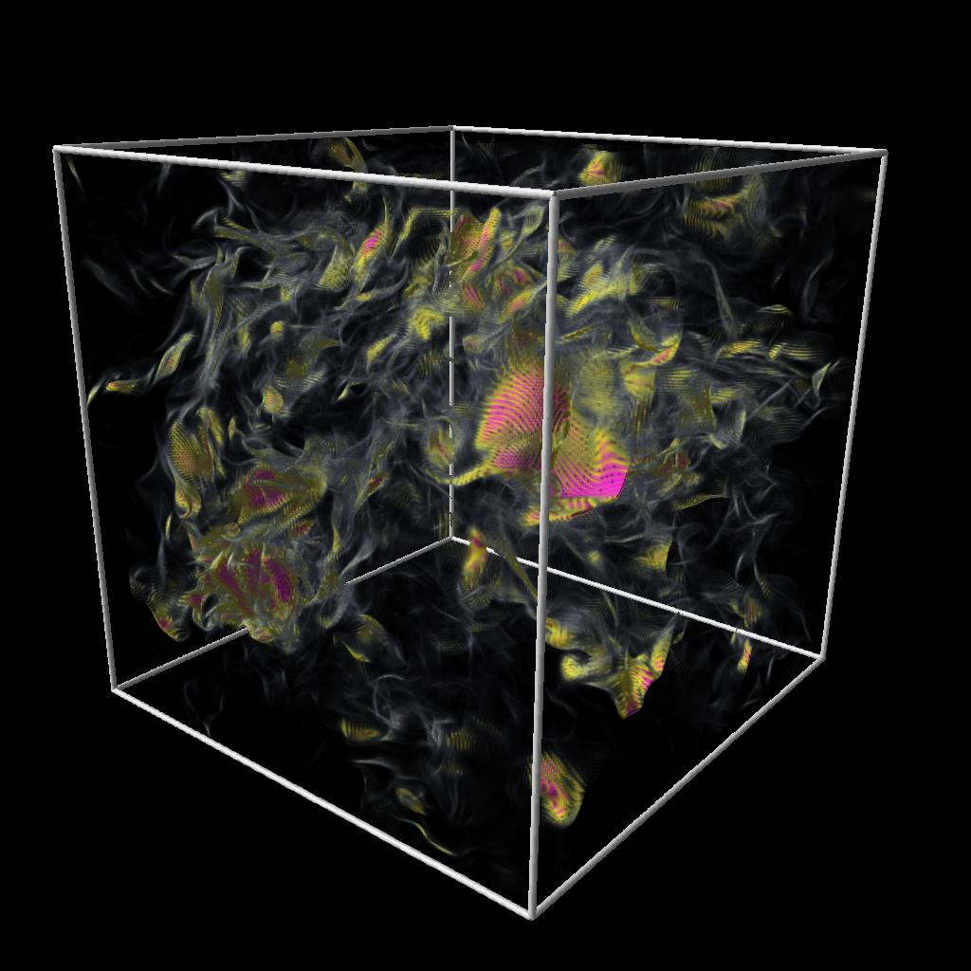
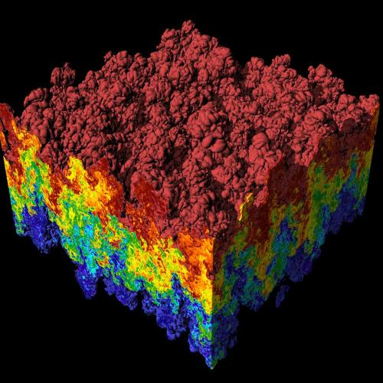
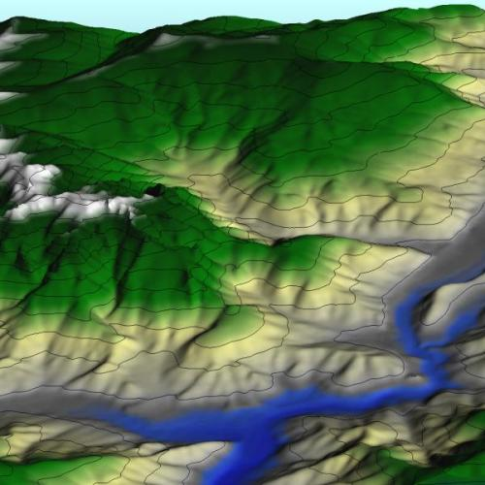
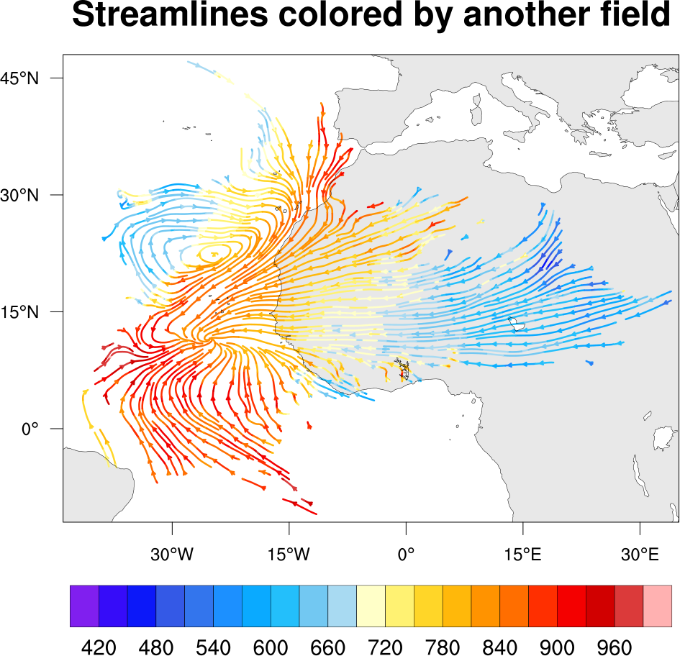
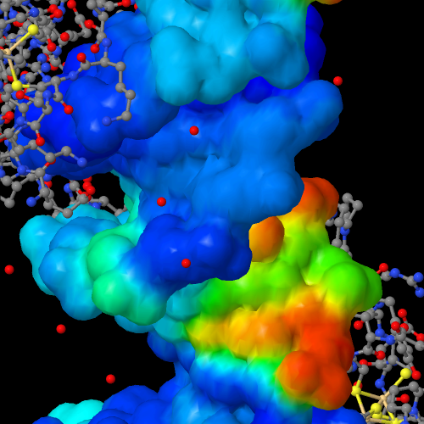
Examples
Notes:
Now let’s take a short tour of some examples of various types of data and how they might be visualized

Slide 9
Notes:
Minard’s famous map of Napoleon’s retreat from Moscow (thanks to Edward Tufte)
Incredibly information-rich without being cluttered
Shows location, army size as the width of the line, time, geographical references, temperature

Slide 10
Notes:
GIS data set shown as a 3d model using the elevation as height
Colored by land cover: blue for water, white for snow, etc.
Also has isosurfaces of height, aka “contour lines”, so you can see three viz techniques at once

Slide 11
Notes:
Sticking with 2d, here we have two dependent variables:
wind velocity, as a vector, and I think pressure
The wind velocity is visualized with streamlines along the vectors, and the streamlines are colored by the pressure at that point.
This is from UCRL at Lawrence Livermore

Slide 12
Notes:
This is a visualization of Rayleigh/Taylor instability in the interface between immiscible fluids of different densities.
They use an isosurface, probably of density, and two slicing planes so you can see how tangled up the fluids get.
I think this one is particularly beautiful, but just imagine how much cooler it would be in motion!

Slide 13
Notes:
This shows so-called “direct” volume rendering; each “voxel” is given a color and an opacity. It gives a look like abstract clouds.
This is a good technique for showing complex interior structure; it’s also often used in medical visualization (CAT scans).
It can be computationally intense, but modern GPUs can do it in real time. It’s starting to even be used in games!

Slide 14
Notes:
This is more like my own work; we start with 3d coordinates for each atom within the molecule, and build a 3d “ball and stick” model of the molecule, colored by element.
Then we add an isosurface of electric potential around part of it, and color that by another dependent variable – I’m not sure what that one is in this case.

Slide 15
Visualization Pipeline
Collect Data
Preprocess/filter
Apply visualization algorithms
Render
Display
Repeat!
Notes:
Once you have your data, whether experimental or theoretical, and you have an idea of how you want to present it, you’ll need to follow some variation of this path to get your data into visual form. You’ll very likely have to preprocess it using something like python, R, MATLAB, to get it onto a visualizable form. Then you’ll apply some visualization algorithms, like isosurfacing or coloring, to turn the data into graphics, and render the resulting graphics into images. Then admire what you got, learn from the results, and go back and improve!

Slide 16
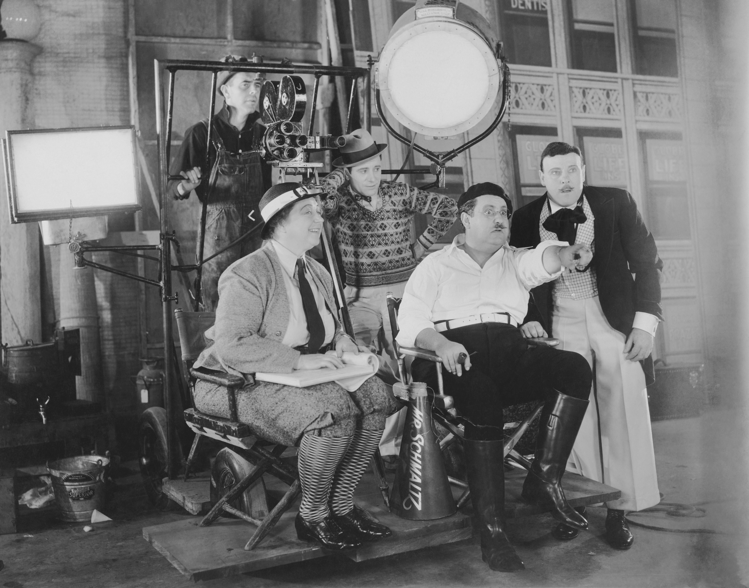
Part 2: The Language of Film
Film is an unspoken language we all share
It consists of concepts like color, light, composition, staging, action, mood, editing, sound, and music
Film is less than 150 years old, unlike music (our oldest language) and the spoken word – but it’s become central to our storytelling because of its high bandwidth, multisensory nature and tremendous emotional capacity.
Notes:
Like spoken language, it has syntax and grammar, but the elements are things like …
Interestingly, it’s not obvious why flickering still images, quick “cuts”, odd camera angles, sudden musical shifts, and focus changes should “work” – why aren’t those disorienting? We grow up with this language and respond to it instinctively
https://www.premiumbeat.com/blog/film-theory-invisible-edits/ - editing works because we are always editing our own perceptions: from eye-blinks to “zoning out” during the morning commute. Our memories are chunked into “shots” as well.
Music videos are great example of quick high-energy cuts, but Sesame Street introduced it fifty years ago

Slide 17
Storytelling with Video
Color and lighting create interest, communicate mood, and clarify structure
Camera motion and composition orient the viewer, help them focus, and can build dramatic tension: start with a long shot, move in for a medium shot, then a close-up.
Depth of field draws the user’s eye to the object of interest.
Editing: just as with text, editing keeps the story moving. People expect a few seconds per shot.
Music sets the mood: the same video will have dramatically different impact with a bouncy soundtrack compared to a minor-key, mysterious one.
Notes:
In the creation of a movie or a commercial, the creators bring all these elements into play in the service of telling the story.

Slide 18
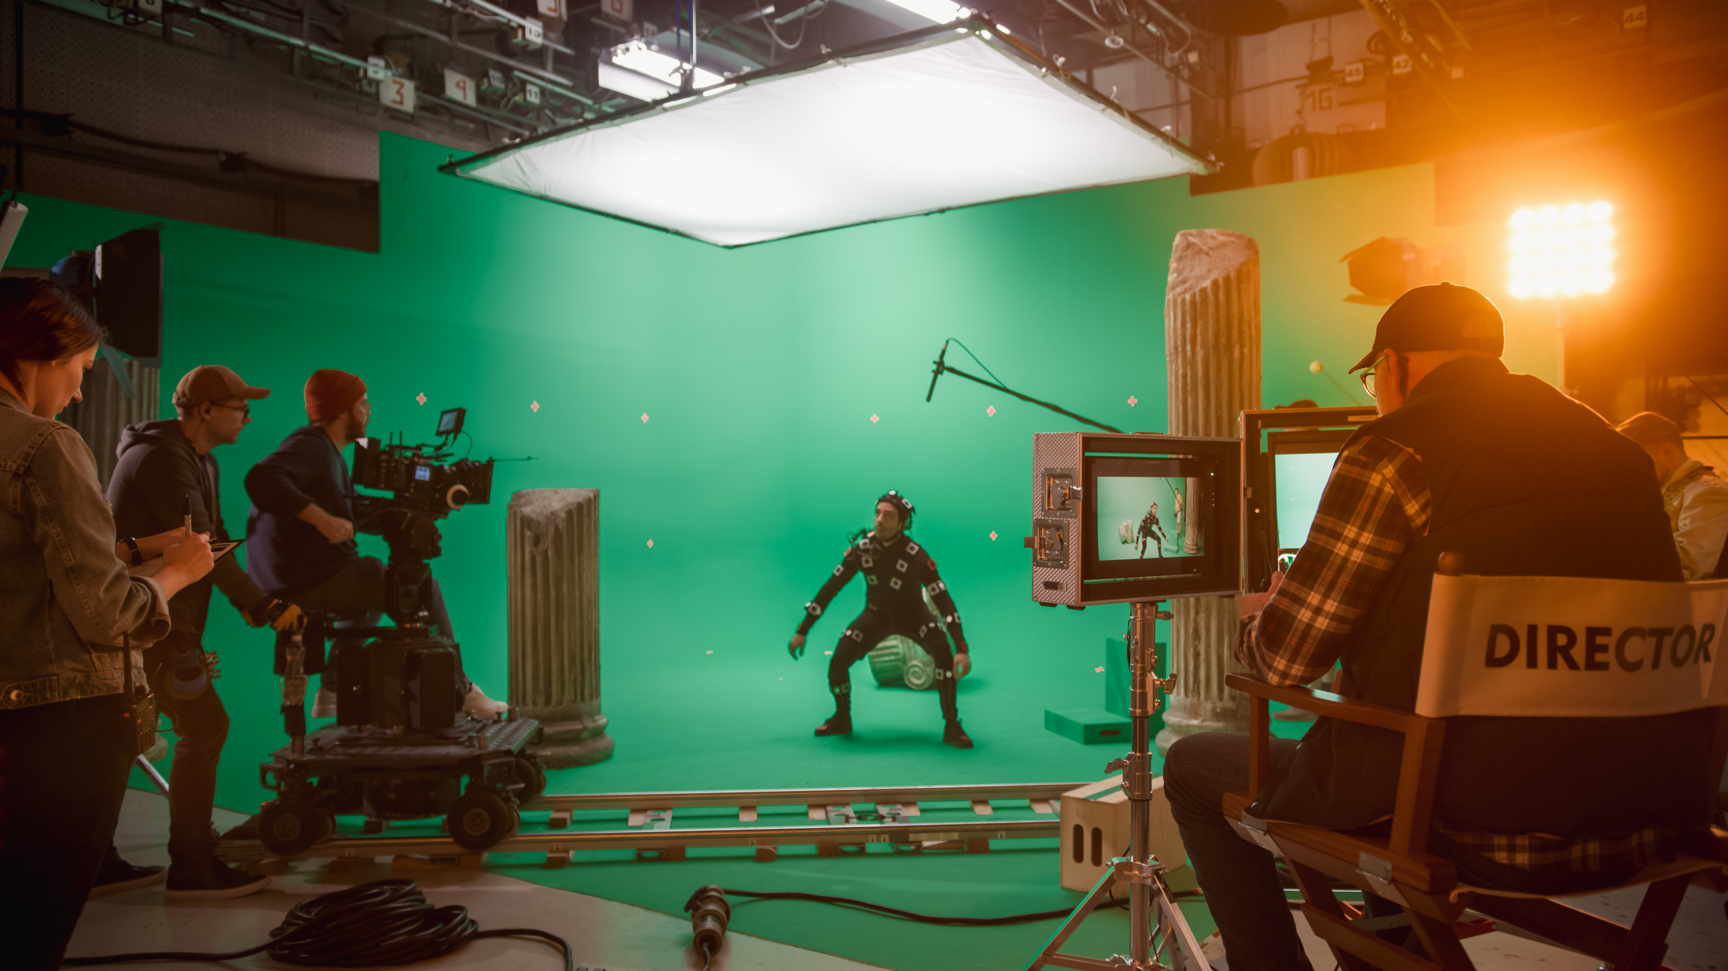
Video Creation Pipeline
Storyboard
Script
Shoot and/or create
Edit
Add titles/effects
Deliver
Notes:
If you’re going to create a Hollywood epic or even just a short commercial, you’ll follow a pipeline pretty much like this.
It can get quite involved, time-consuming and expensive!
But you don’t have to go through all of this to create a scientific video.

Slide 19
Part 3: Visualizing with Video
Keep It Simple
In a scientific presentation, video can be a small but important part
A single “shot” as an intro, conclusion, or highlight can add “wow” and clarify important concepts
Single shot avoids the need for storyboarding, editing, music, most post-production, and keeps the “script” simple
Use one or two viz techniques, one camera move, one choice of color scheme, and simple animation
Plus: a short animation makes a great social media post and website video
Notes:
[Talk to bullet points]
The element of time adds a lot of complexity, but also tremendous ability to tell a story
Video tools are usually more complex than still-image tools, take longer to learn, and longer to render
But the results are worth it!

Slide 20
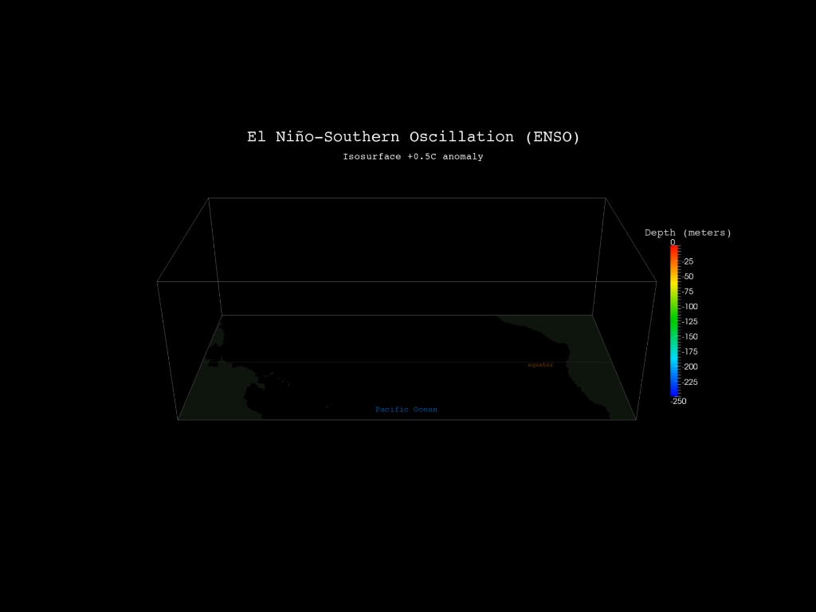
Video Examples
Notes:
The first animation is a volumetric data set of the Pacific Ocean, with an isosurface marking the places above half a degree of temperature anomaly.
It shows the development of an El Nino; the color represents depth below the surface, because they want to emphasize how deep the temperature gradient runs.
You can see how it develops over time, starting in the south, and growing northward.
The second animation is from an experimental data set where they photographed bubbles moving in a chamber, tracked them, and developed that into a complete flow field (velocity at every point in space). Then they visualize that with these cool hairs, that change into a set of isosurfaces of vorticity.

Slide 21
Sampling of Video Creation Tools
Python tools: scipy, pyplot, vispy, VTK, yt (see pyviz.org)
  many of these can create 3d scenes with animation as well as standard plots
  But use what you’re familiar with: R, MATLAB… anything but Excel! ☺
Blender for creating 3d graphics (open source, rapidly improving, highly capable)
  polygons, lines, volumes
  full animation, titling, and simple editing capability
Houdini/Maya for creating 3d graphics ($, used in high-end sci viz projects)
Adobe Premiere, Final Cut Pro for editing ($)
Lightworks for editing (free), OpenShot (open source)
Handbrake for video format conversion
Notes:
You’ll want to use a specialized tool, or custom code, to transform your data into a standard format (2d/3d), and then you can use some of these tools to create visualizations

Slide 22
Creating Motion Graphics from Data
For animated images, just create individual still frames and collect them together like a stop-motion animation with a video editor: use Final Cut, Lightworks, or Premiere
For 3d data, create polygons and lines via isosurfacing, streamlines, height field, etc.: .glTF, VRML, obj are common formats. These can even be viewed online in a web browser. Then add a simple background with lights; follow web tutorials.
Direct volume rendering: Blender and Houdini can do this, even with animated volumes! Format: OpenVDB – also dxbin, hdf, raw
  Real-time is starting to be practical: https://draemm.li/various/volumeRendering/webgl2/
Notes:
Direct volume rendering: switch to browser to show real-time brain. This tool doesn’t let you create videos, and you’d have to do some work to upload your own data set, but you can do a screen recording.

Slide 23
Specialized Tools
yTini: Houdini interface to yt to create cinematic scientific visuals for astronomy, cosmology
BioViz Studio: web-based tool for structural biology visualization
  Artist-created backgrounds and camera moves
  Uses Blender in the cloud for fast 3d rendering
  Result: 5-10 sec single clip for use in a presentation
  No programming, start to finish in 30 min
Notes:
yTini, a Houdini interface to python’s yt, is developed and used by NCSA for their incredible cinematic scientific visualization work; definitely check out Kalina Borkiewicz’s work there, when you’re at a planetarium. It’s open source and if you’re in aero/astro, that’s the tool for you.
BioViz Studio is my own tool; I created it for making beautiful videos of molecular structures.
I tried to encapsulate and automate many of the film techniques I mentioned earlier, using artist-created backgrounds and camera moves, and using Blender behind the scenes.
This video is one I created the other day; it shows the antiviral drug Molnupiravir causing mutations in SARS-CoV2.
I’m interested in extending it to other scientific domains; please see me afterwards if you’re interested in something like this.

Slide 24
How to Get Started?
Keep it simple
Use video sparingly at first
Start with python and maybe Blender; they have excellent, supportive communities
Work with the university’s science communications department
Have fun!
Notes:
[Read bullets – OK to go fast, the animation is 0:51 long]
There is nothing as fun as creating beautiful imagery from raw data!

Slide 25
References
Color:
  Adobe Color: color.adobe.com/create/color-wheel/
  Color Brewer: colorbrewer2.org/
  Colorpicker for Data: tristen.ca/hcl-picker
Viz Tools:
  Blender: bioblender.org/, astroblend.com/
  Python: scipy, VTK, yt-project.org/,
  Paraview: paraview.org/web/ (Javascript)
  Molecular data: NGL, Mol*
Storytelling:
  Pixar’s 22 Rules: https://www.aerogrammestudio.com/2013/03/07/pixars-22-rules-of-storytelling/
  5 Important Rules for Scientists who Write about Science: https://medium.com/starts-with-a-bang/the-5-most-important-rules-for-scientists-who-write-about-science-3ae7a4b473e
Books:
Visual Strategies, Frankel & DePace, 2012
The Visual Display of Quantitative Information (2nd ed), Tufte, 2001
Notes:
Here are some sites to help you choose good color ranges for lots of different scenarios,
and a list of viz tools I recommend.
Don’t forget that sci viz is still all about storytelling, so here are Pixar’s storytelling rules and another site with good advice for science writing.
And finally here are a couple of good books; Tufte is the classic in information visualization, whereas Frankel & DePace is more about modern scientific visualization techniques.

